Slide 1
Guided by-Mohana priya
Presented By - Shaikh Rijwana

Slide 2
CONTENT
What is the Web?
What is the HTML?
What is javascript?
DBMS(databasemangemnet system)
SDLC(software development life cycle)
Selenium

Slide 3
WHAT IS THE WEB?
The Internet is often confused with the World Wide Web.
The World Wide Web, developed in 1989, is actually one of those different protocols.
The World Wide Web—usually called the Web for short—is a collection of different websites you can access through the Internet.
A website is made up of related text, images, and other resources. Websites can resemble other forms of media—like newspaper articles or television programs—or they can be interactive in a way that's unique to computers.

Slide 4
WHAT IS THE HTML?
HTML – Hypertext Markup Language is a markup language that is used to define how text should be displayed in a browser.
The basic structure of an HTML document includes tags, attributes and elements.
Every web page is actually a HTML file. Each HTML file is just a plain-text file, but with a .html file extension. Most tags come in pairs, called the opening tag and the closing tag. An opening tag consists of tag name contained within angled brackets.
A closing tag is strat with bracket in (/).

Slide 5
CSS AND XML
Css stand for cascading style sheet.
And his provide html with layout and design or
our webpage become attaractive preety and beautiful.
There are three mainly type:
1 Inline css
2 internal css
3 external css

Slide 6
XML
EXtensible Markup Language (XML) is a way to apply structure to a web page.
XML provides a standard open format and mechanisms for structuring a document so that it can be easily exchanged and manipulated.
XML documents are composed of elements, by a start tag (of the form <element_name>) and an end tag (of the form </element_name>)
Declarion-<?xml version=“1.0”>

Slide 7
WHAT IS JAVASCRIPT?
Java script is client-side scripting language.
It is also known as scripting language.
By using the<scripy> tag to define a client scrrpting language.
Widely uses in js is adding interactive behvaoiur to web page.
Also create web and mobile application.
Syntax- Document.write(“Hello”);
This is the method to print the javascript.
You can write n number of script of body section.

Slide 8
PREDEFINED OBJECT
There are two type of object:
1)Boolean Object
2)Date object
1)Boolean obj- Boolean object is wraper around the primitive data type.
Syntax- var Boolean object Name= new Boolean(value);
2)Date object-in data object large number of method for setting getting dates.
Syntax- var date object name=new date([parameter]);

Slide 9
DBMS(DATA BASE MANAGEMENT SYSTEM)
Data is collection of related information.
Dbms is a symmentric collection of data.
Also dbms support manage and manuplicating data.
In dbms we collect the data and restore and retivew them.
In SQL means Structred query languange.
By use these language we can easily insert,delete update,serach,
Database record.
Sql develop ANSI-1986,ISO-1987.

Slide 10
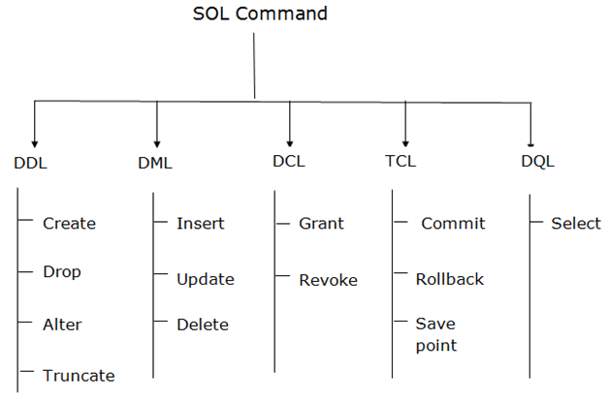
SQL COMMAND

Slide 11
1.DDL-Data definition lang
DDL-Data definition lang.
DDL changes the structure of the table like creating a table, deleting a table, altering a table, etc.
1.create-It is used to create a new table in the database.
Synatax-CREATE TABLE TABLE_NAME (COLUMN_NAME DATATYPES[,....]);
2.drop- It is used to delete both the structure and record stored in the table.
Sytax-DROP TABLE table_name;

Slide 12
3.Alter-It is used to alter the structure of the database.
Synatx-ALTER TABLE table_name ADD column_name COLUMN-definition;
4.Trunacte-It is used to delete all the rows from the table and free the space containing the table.
Syntax-TRUNCATE TABLE table_name;

Slide 13
2)DML-DATA MANUPLIATION LANG.
DML-Data manupliation lang.
DML command used to modify database.
1.Insert- The INSERT statement is a SQL query. It is used to insert data into the row of a table.
Syntax-INSERT INTO TABLE_NAME
VALUES (value1, value2, value3, .... valueN);
2.Update- This command is used to update or modify the value of a column in the table.

Slide 14
Syntax-UPDATE table_name SET [column_name1= value1,...column_nameN = valueN] [WHERE CONDITION]
3.Delete-It is used to remove one or more row from a table.
Synatx-DELETE FROM table_name [WHERE condition];

Slide 15
3)DQL-Data Query language/Data Retrivew Language
DQL-Data Control language/data retrivew lang.
DQL statement are used to performing quries within schema object.
Retrivew means getting data.
And with the help of SELECT command allows getting the data of database.
1.select- It is used to retrievew the database.
Syntax-SELECT expressions FROM TABLES
WHERE conditions;

Slide 16
4)DCL-Data Control language
DCL-data control languge.
DCL commands are used to grant and take back authority from any database user.
1.Grant: It is used to give user access privileges to a database.
Example-GRANT SELECT, UPDATE ON MY_TABLE TO SOME_USER,
ANOTHER_USER;
2.Revoke: It is used to take back permissions from the user.
Example-REVOKE SELECT, UPDATE ON MY_TABLE FROM USER1, USER2;

Slide 17
5)TCL-Transation control languge.
TCL-Transation control languge.
Transaction withim the database.
1. Commit: Commit command is used to save all the transactions
to the database.
Example- DELETE FROM CUSTOMERS WHERE AGE = 25;
COMMIT;
2.Rollback: Rollback command is used to undo transactions
that have not already been saved to the database.

Slide 18
Example- DELETE FROM CUSTOMERS WHERE AGE = 25; ROLLBACK;
3. SAVEPOINT: It is used to roll the transaction back to a certain point without rolling back the entire transaction.
Syntax-SAVEPOINT SAVEPOINT_NAME;

Slide 19
5)SDLC-SOFTWARE DEVELOPMENT LLIFE CYCLE
Requiremnet gathering
Deploymnet
Analysis
SDLC LIFE CYLE
Testing
Design
Coding

Slide 20
1) Requirement Gathering Analysis
During this phase, all the relevant information is collected from the customer to develop a product as per their expectation
2) Analysis
Business analyst and Project Manager set up a meeting with the customer to gather all the information like what the customer wants to build, who will be the end-user, what is the purpose of the product. Before building a product a core understanding or knowledge of the product is very important.
3) Design
In this phase, the requirement gathered in the SRS document is used as an input and software architecture that is used for implementing system development is derived.

Slide 21
4)coding-Coding starts once the developer gets the Design document. The Software design is translated into source code. All the components of the software are implemented in this phase.
5)testing-Testing starts once the coding is complete and the modules are released for testing. In this phase, the developed software is tested they any defects found are assigned to developers to get them fixed.
Retesting, regression testing is done until the point at which the software is as per the customer’s expectation. Testers refer SRS document to make sure that the software is as per the customer’s standard.

Slide 22
6)Deployment
Once the product is tested, it is deployed in the production environment or first UAT (User Acceptance testing) is done depending on the customer expectation.
In the case of UAT, a replica of the production environment is created and the customer along with the developers does the testing

Slide 23
SELENIUM
Selenium is an open-source, automated testing tool used to test web applications across various browsers. Selenium can only test web applications, unfortunately, so desktop and mobile apps can’t be tested. However, other tools like Appium and HP’s QTP can be used to test software and mobile applications.
Selenium IDE was developed by shinya kasatani.
You can automated your application.
When you create driver object then it automatically import the two package.
That is driver.get – is the predefined method.

Slide 24



